Slide 1

Floral biodiversity estimation of grasslands in Franconia using Sentinel-2
12.03.2024
Laura Obrecht

Slide 2
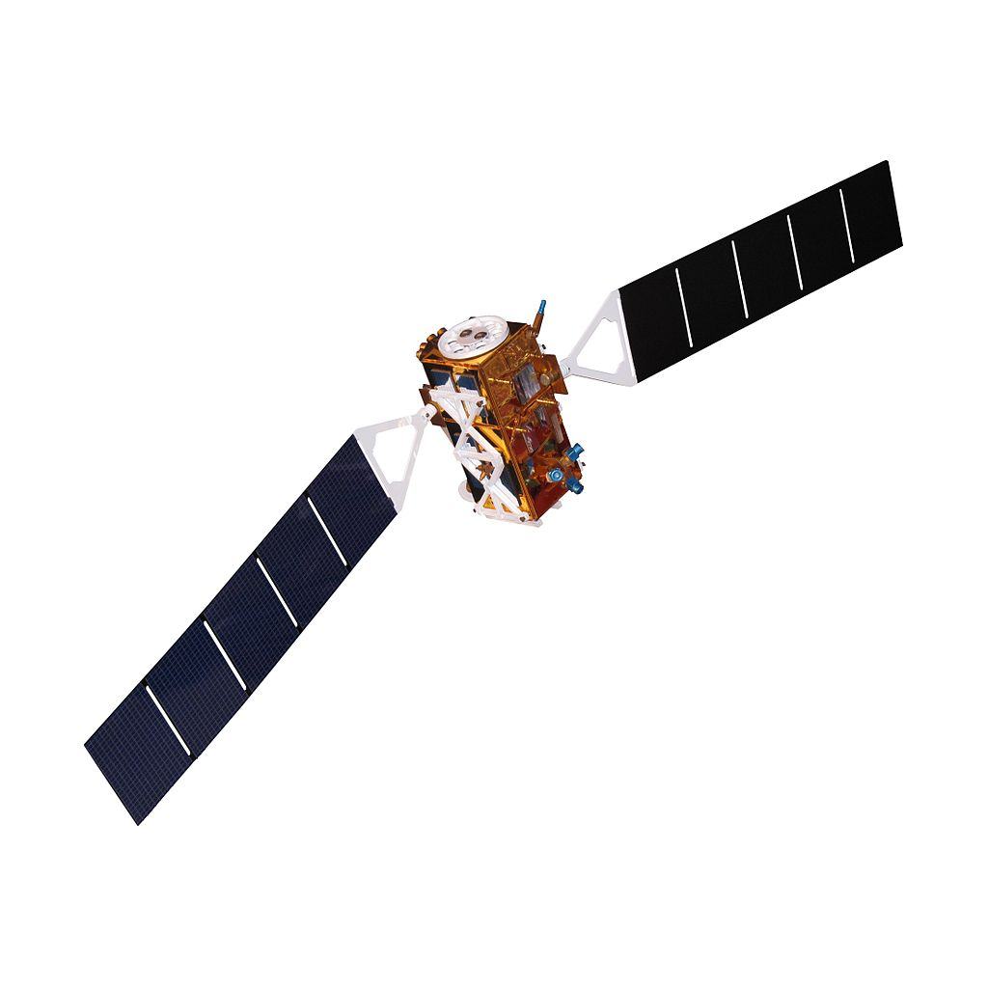
Topics

Slide 3
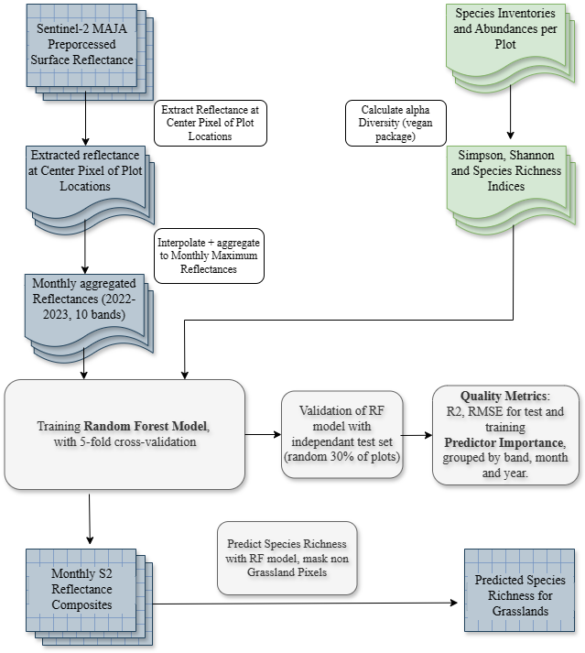
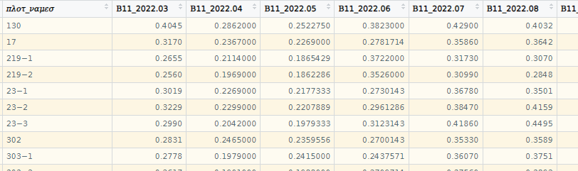
Workflow
Figure. Monthly aggregated Reflectance (2022-2023), input to Random Forest. (Screenshot from RStudio)
Notes:
Information on code, packages

Slide 4
Alpha Diversity Indices
Species Number closest to „Normalverteilung“
Best Predictor, followed by Shannon Index

Slide 5
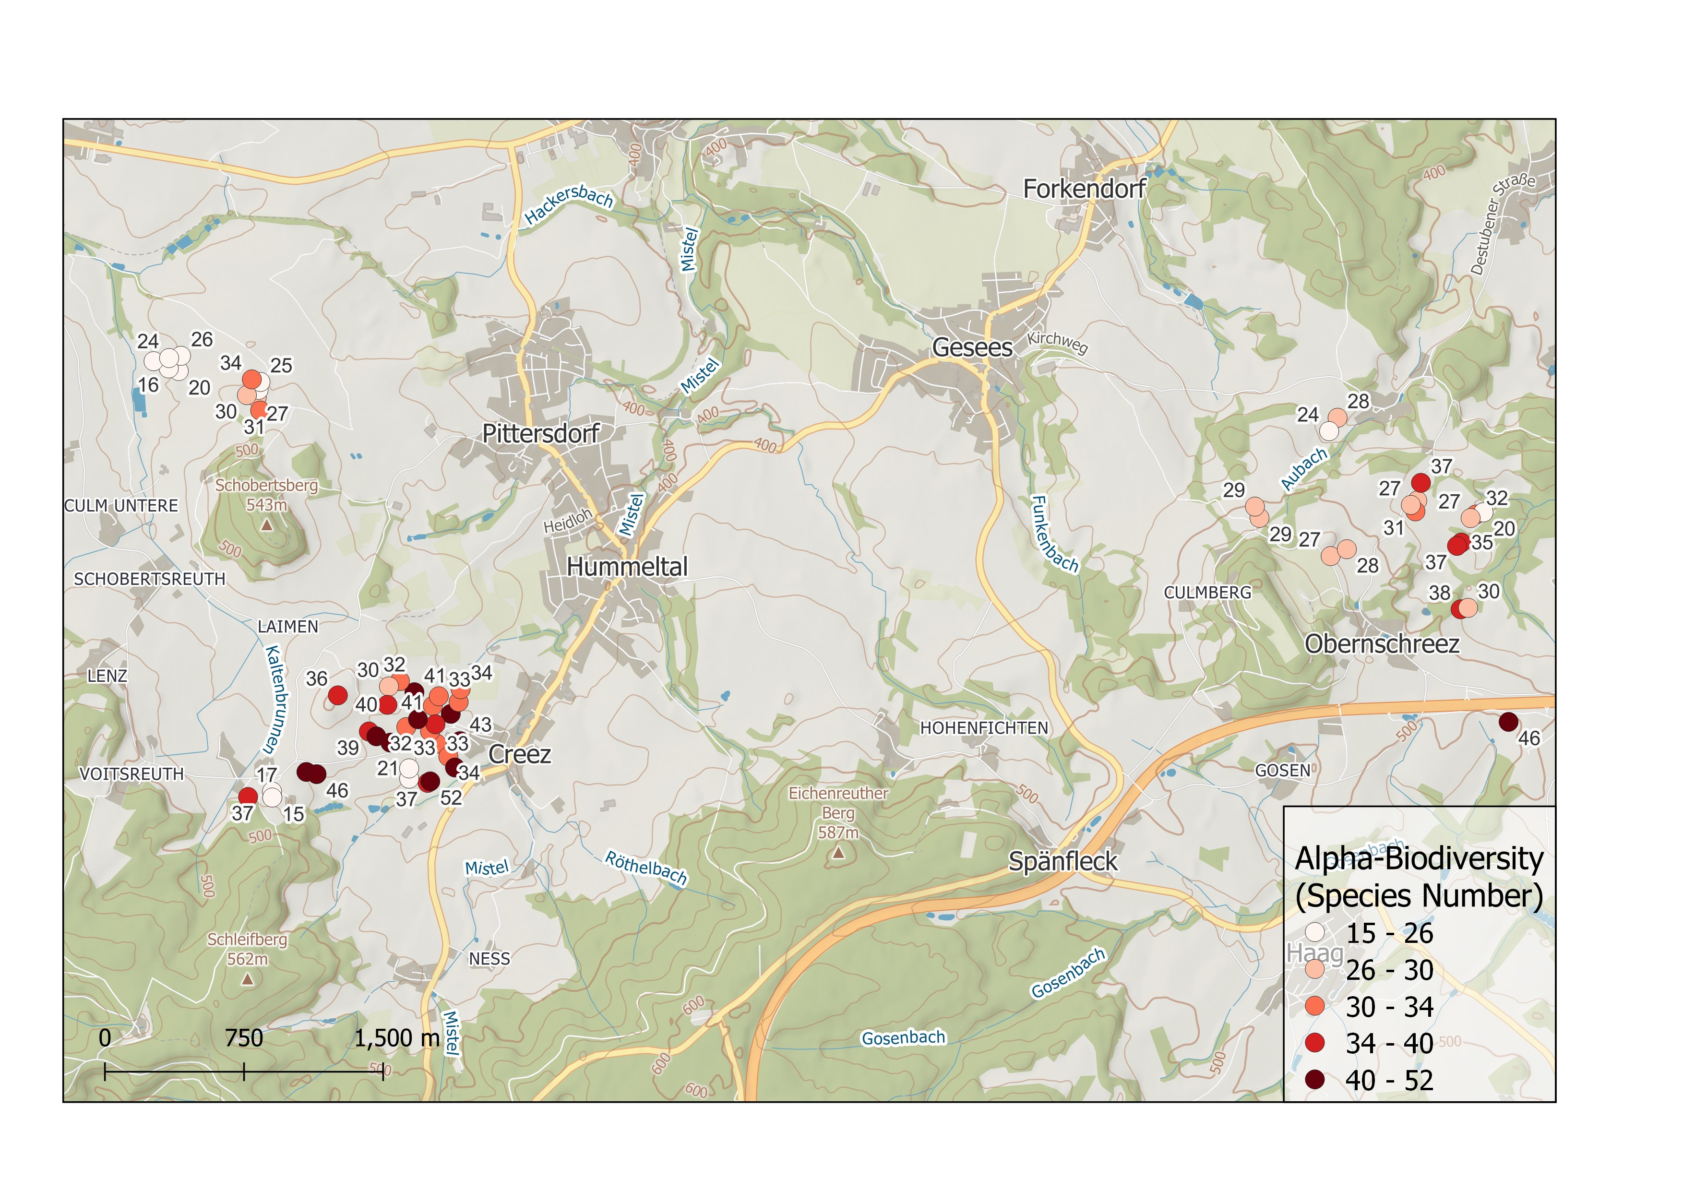
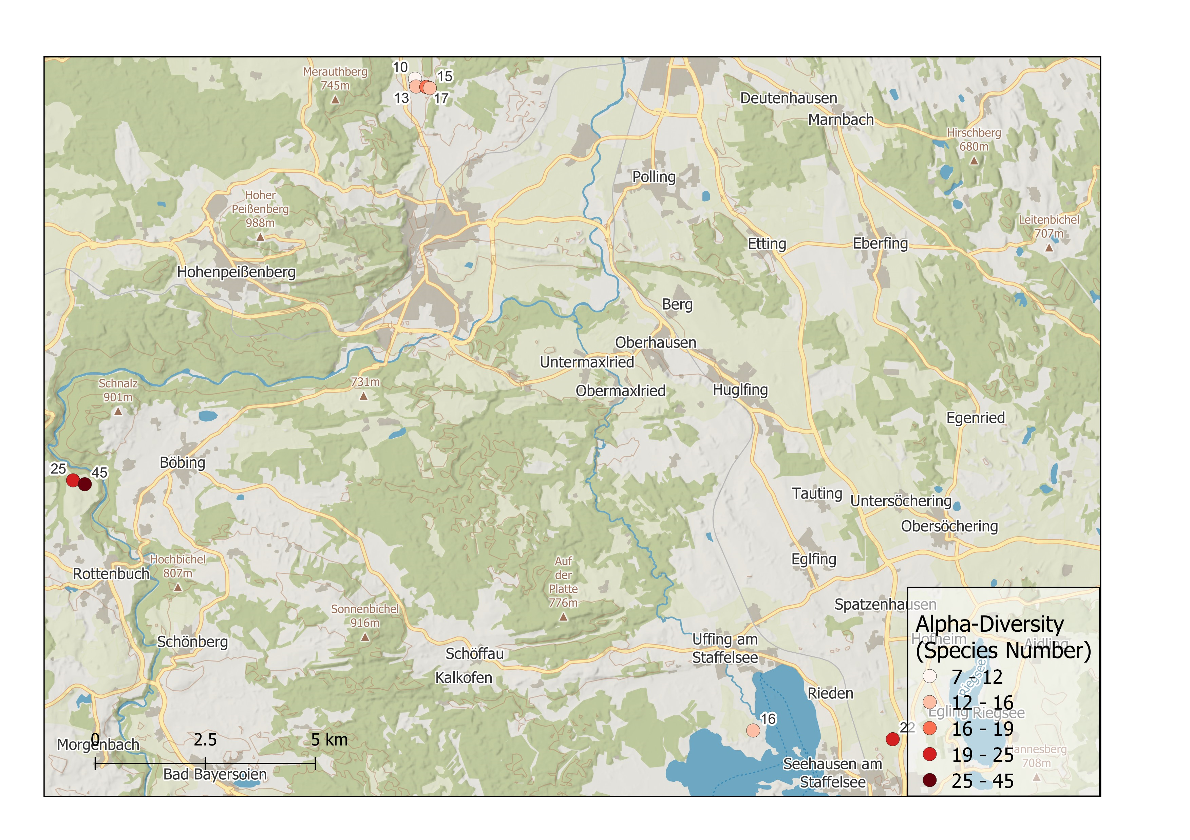
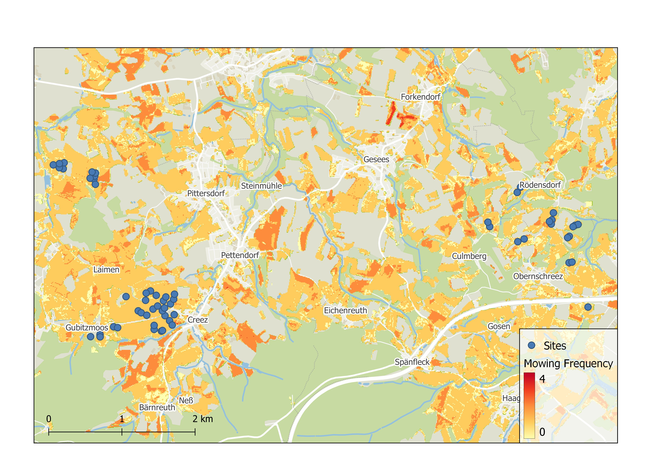
Random Forest Predictors
Training and Testing with data from Lower Franconia
Training and Testing with data from Lower Franconia and Ammer Catchment
Mowing Frequency, DOY of first Cut as additional Predictors
Notes:
Karten Untersuchungsgebiet (QGIS), Plot von Mowing Raster als Motiv
Duplicate Slide to present results for different cases in the end

Slide 6
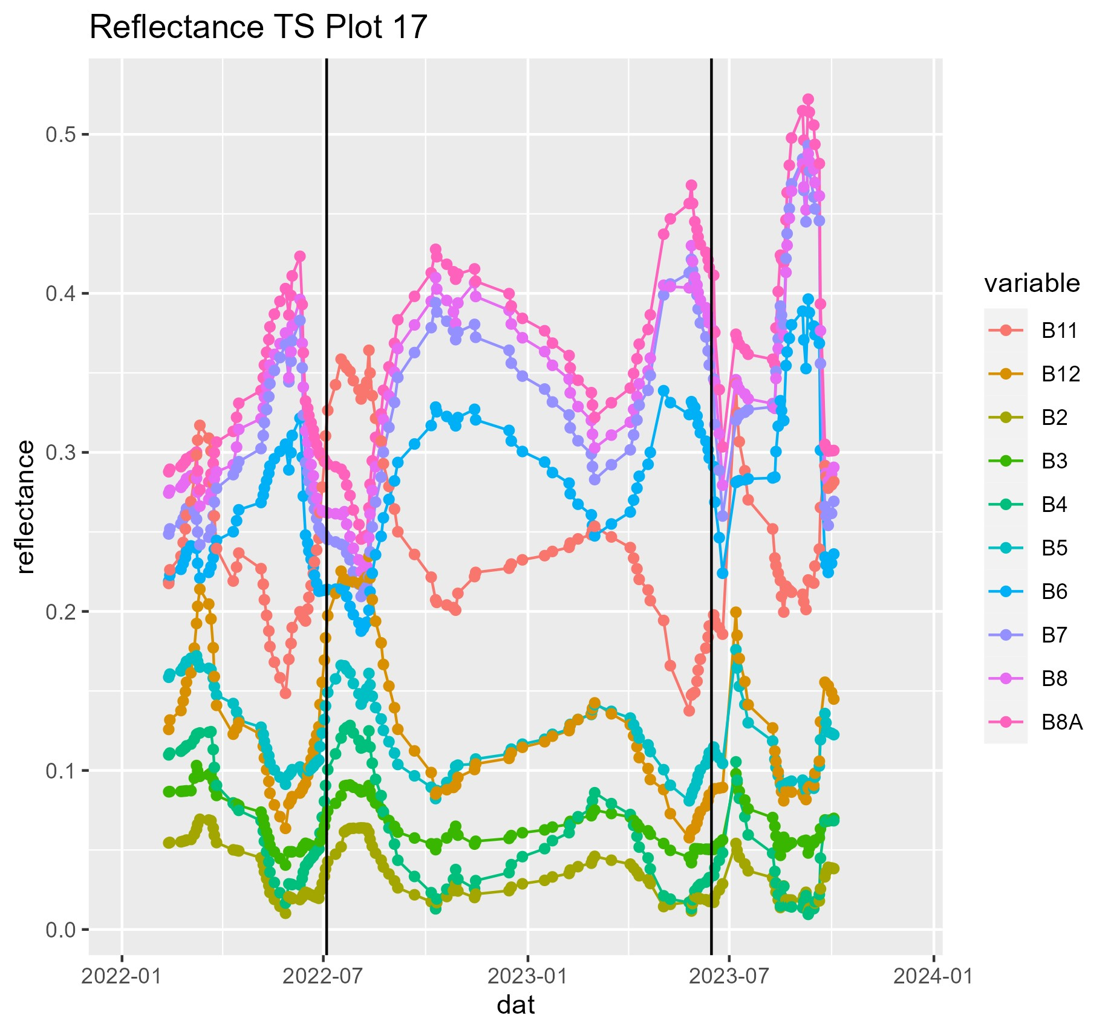
S2 Time Series extracted at Center Pixel

Slide 7
Monthly Compositing of S2 Reflectance per Band
Trend per Band after Cut
Goal is to ensure that RF is not trained/influenced by Mowing Events/Frequency
Bands increasing after mowing are composited as minimum composites, bands decreasing are composited as maximum

Slide 8
Comparison of Compositing Methods
Predictors | Resp_var | seed | R2 | RMSE | stdev | var1 | var2 | var3
Median | specn | 75 | 0.644 | 5.399 | 0.286 | B3_2022.07 | B3_2023.08 | B11_2023.08
Median | specn | 3 | 0.68 | 5.223 | 0.261 | B4_2022.04 | B4_2022.03 | B3_2023.08
Median | specn | 87 | 0.675 | 5.714 | 0.236 | B11_2023.04 | B12_2022.03 | B4_2022.03
Median | specn | 77 | 0.734 | 5.443 | 0.226 | B4_2022.04 | B4_2022.03 | B12_2022.03
Median | specn | 67 | 0.507 | 5.357 | 0.324 | B4_2022.04 | B3_2022.09 | B5_2022.04
Max | specn | 86 | 0.617 | 5.517 | 0.269 | B12_2023.03 | B11_2023.03 | B4_2022.04
Max | specn | 40 | 0.576 | 5.435 | 0.304 | B5_2022.03 | B4_2022.04 | B12_2022.03
Max | specn | 84 | 0.677 | 5.27 | 0.258 | B11_2023.03 | B4_2022.04 | B5_2022.04
Max | specn | 38 | 0.588 | 5.443 | 0.26 | B11_2022.04 | B4_2022.04 | B11_2023.04
Max | specn | 3 | 0.654 | 5.525 | 0.269 | B5_2022.03 | B4_2022.04 | B11_2023.03
Min | specn | 51 | 0.663 | 5.449 | 0.265 | B12_2022.03 | B12_2022.04 | B4_2022.04
Min | specn | 41 | 0.663 | 4.951 | 0.276 | B4_2023.04 | B11_2023.03 | B11_2023.04
Min | specn | 91 | 0.766 | 5.225 | 0.19 | B5_2022.09 | B12_2023.03 | B11_2023.04
Min | specn | 43 | 0.667 | 5.484 | 0.234 | B5_2022.09 | B11_2023.03 | B4_2022.04
Min | specn | 10 | 0.733 | 4.822 | 0.223 | B2_2022.03 | B4_2022.04 | B12_2023.04
MaxMinperBand | specn | 39 | 0.682 | 5.068 | 0.254 | B12_2023.06 | B3_2023.08 | B11_2023.06
MaxMinperBand | specn | 53 | 0.72 | 5.01 | 0.18 | B3_2023.08 | B5_2022.09 | B3_2023.04
MaxMinperBand | specn | 45 | 0.687 | 5.326 | 0.243 | B5_2022.09 | B3_2023.08 | B11_2023.03
MaxMinperBand | specn | 27 | 0.675 | 5.325 | 0.253 | B4_2022.03 | B3_2023.08 | B5_2023.04
MaxMinperBand | specn | 8 | 0.685 | 5.016 | 0.253 | B3_2023.08 | B12_2023.03 | B4_2023.04

Slide 9
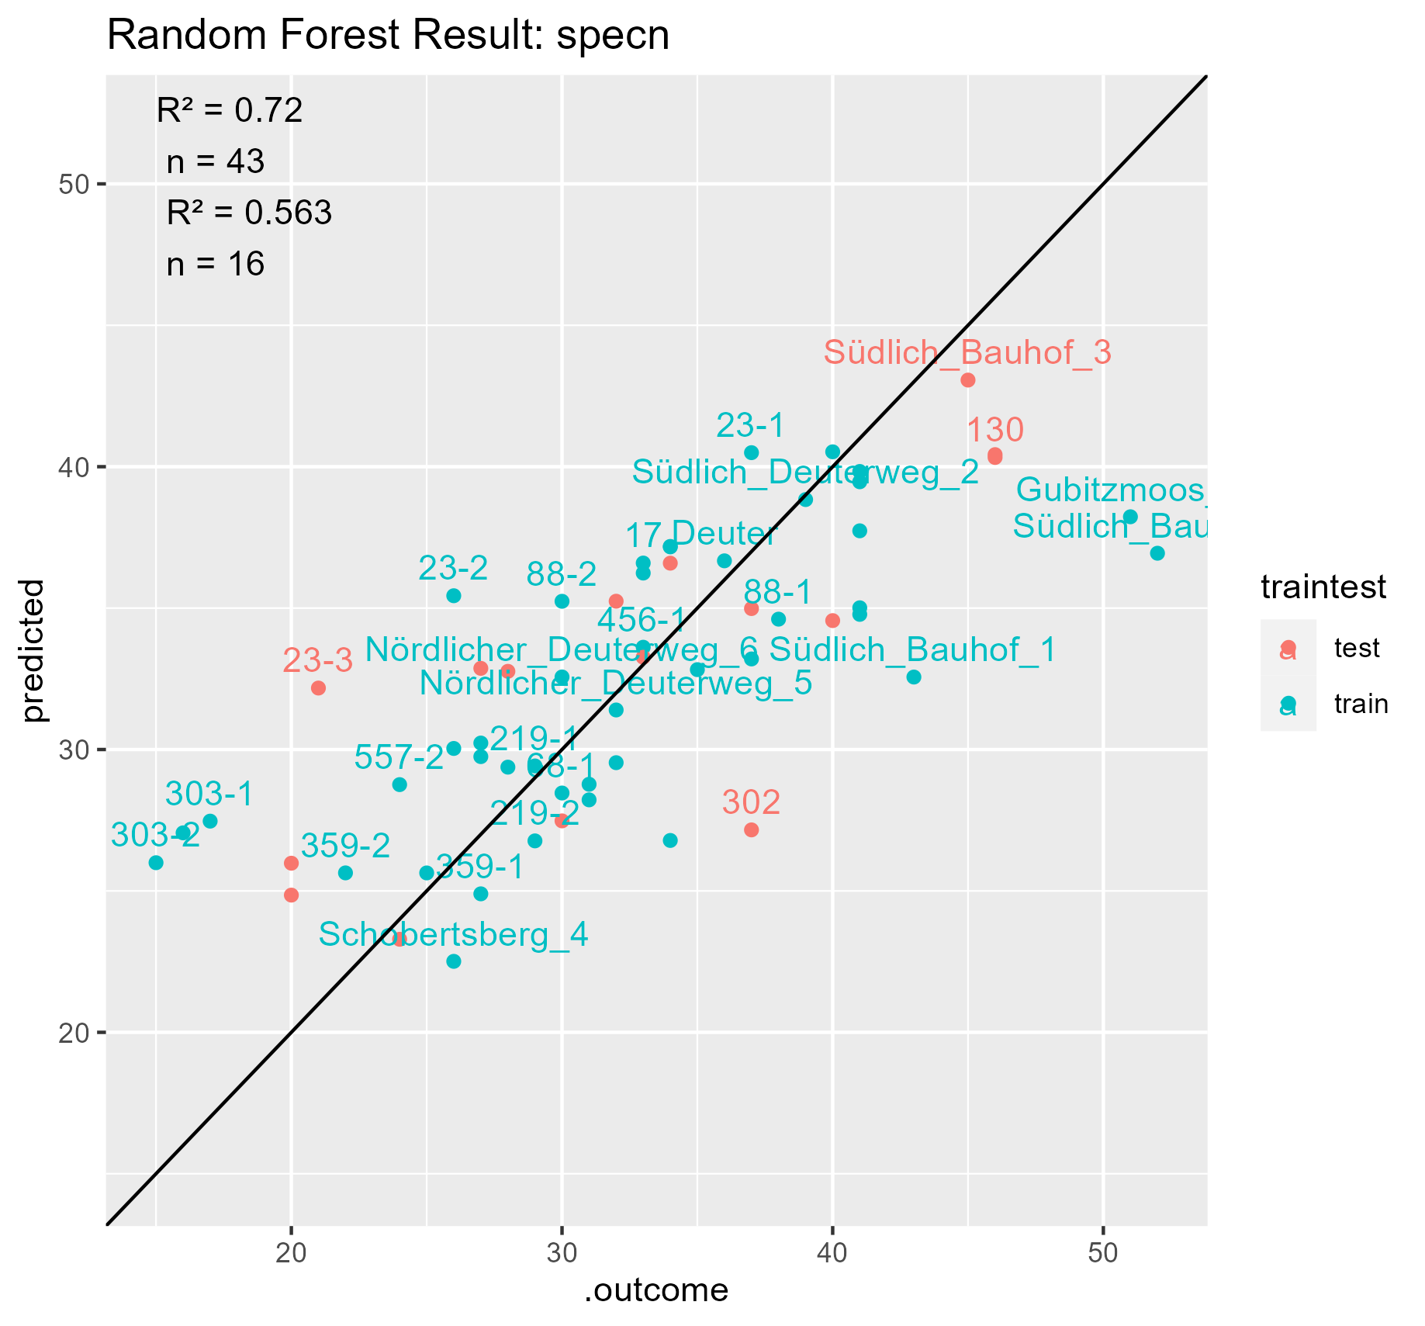
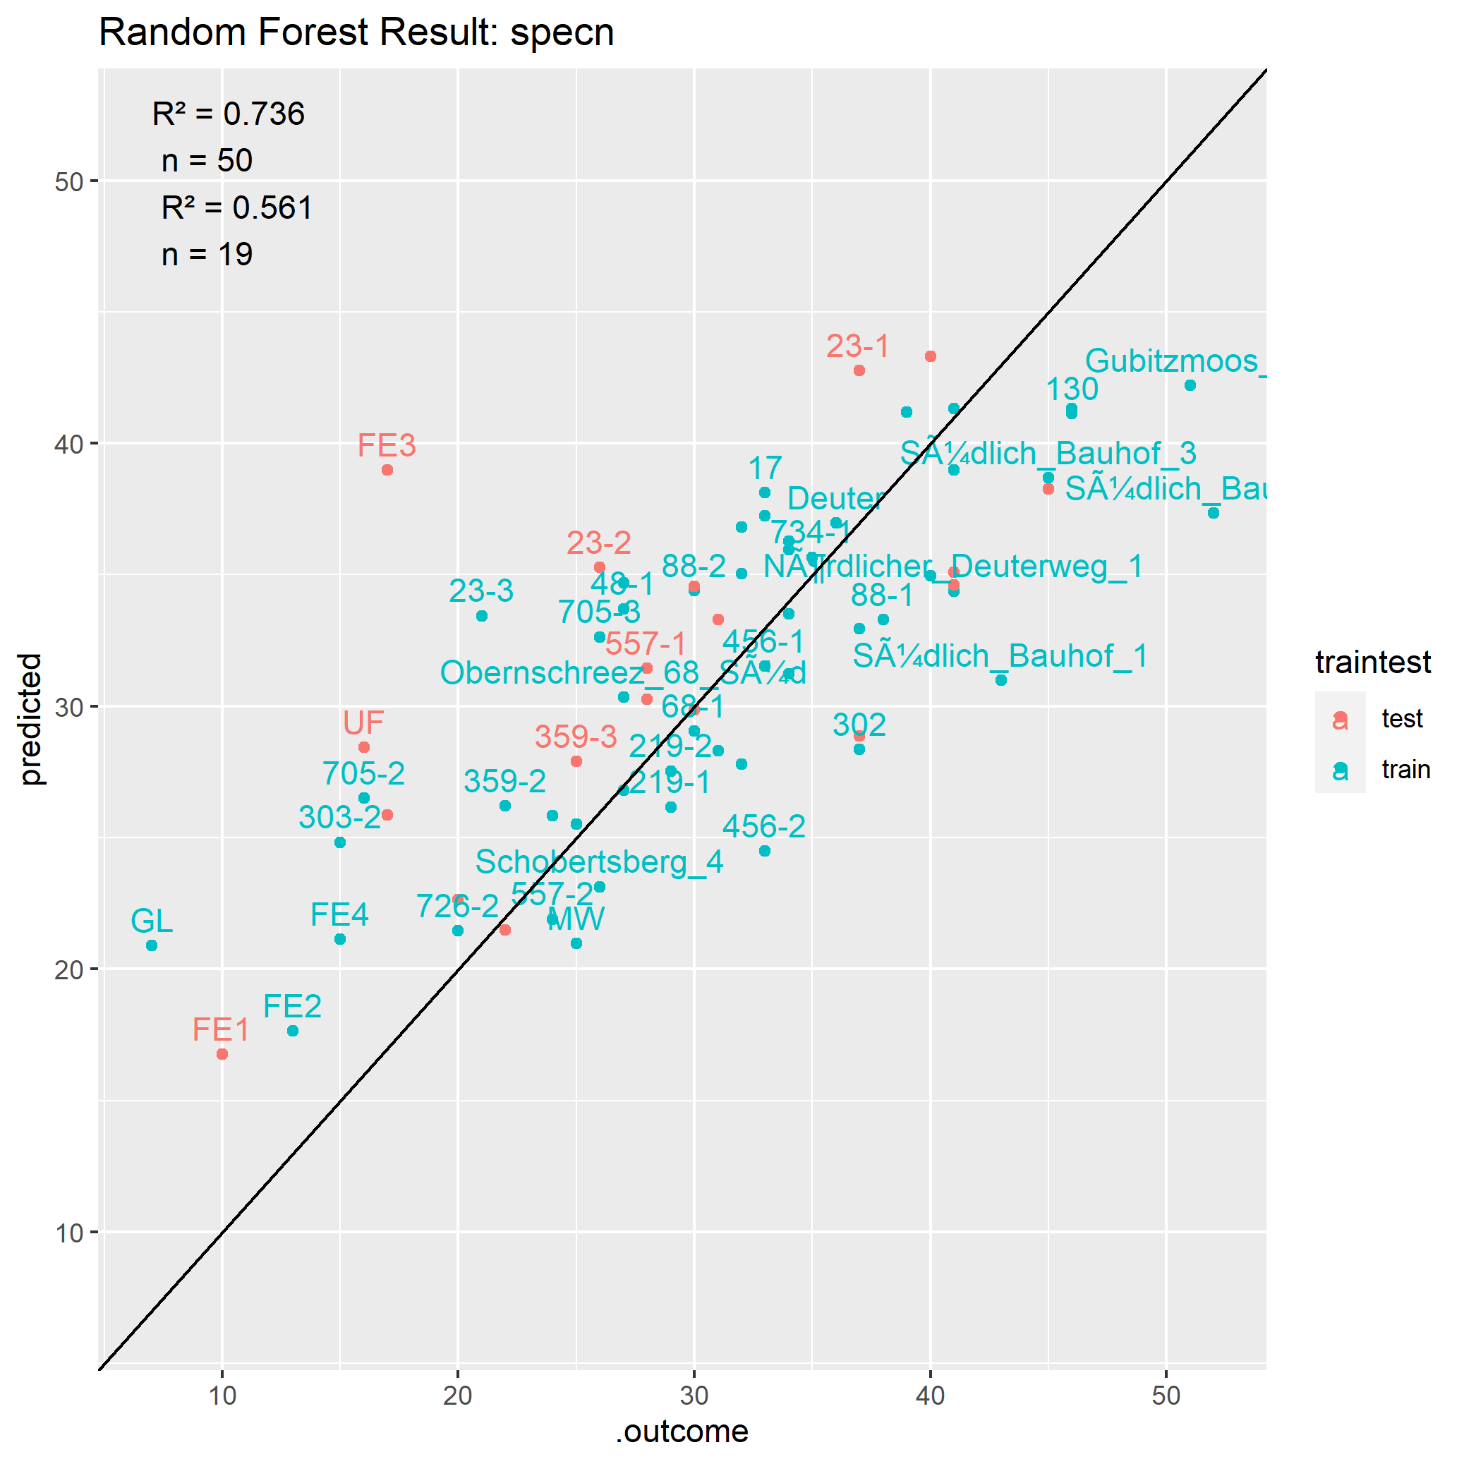
Comparison Training with and without samples from Ammer Catchment
Notes:
Ammer andere Form als Bayreuther Flächen
Beschriftung ändern

Slide 10
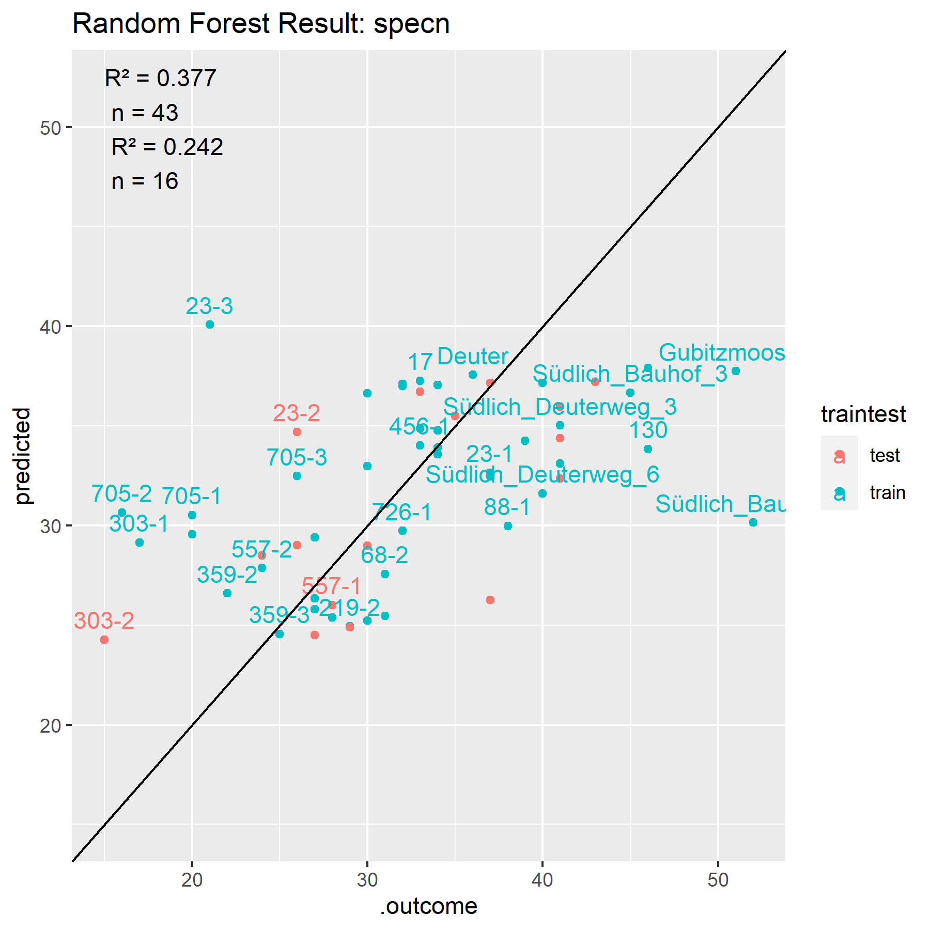
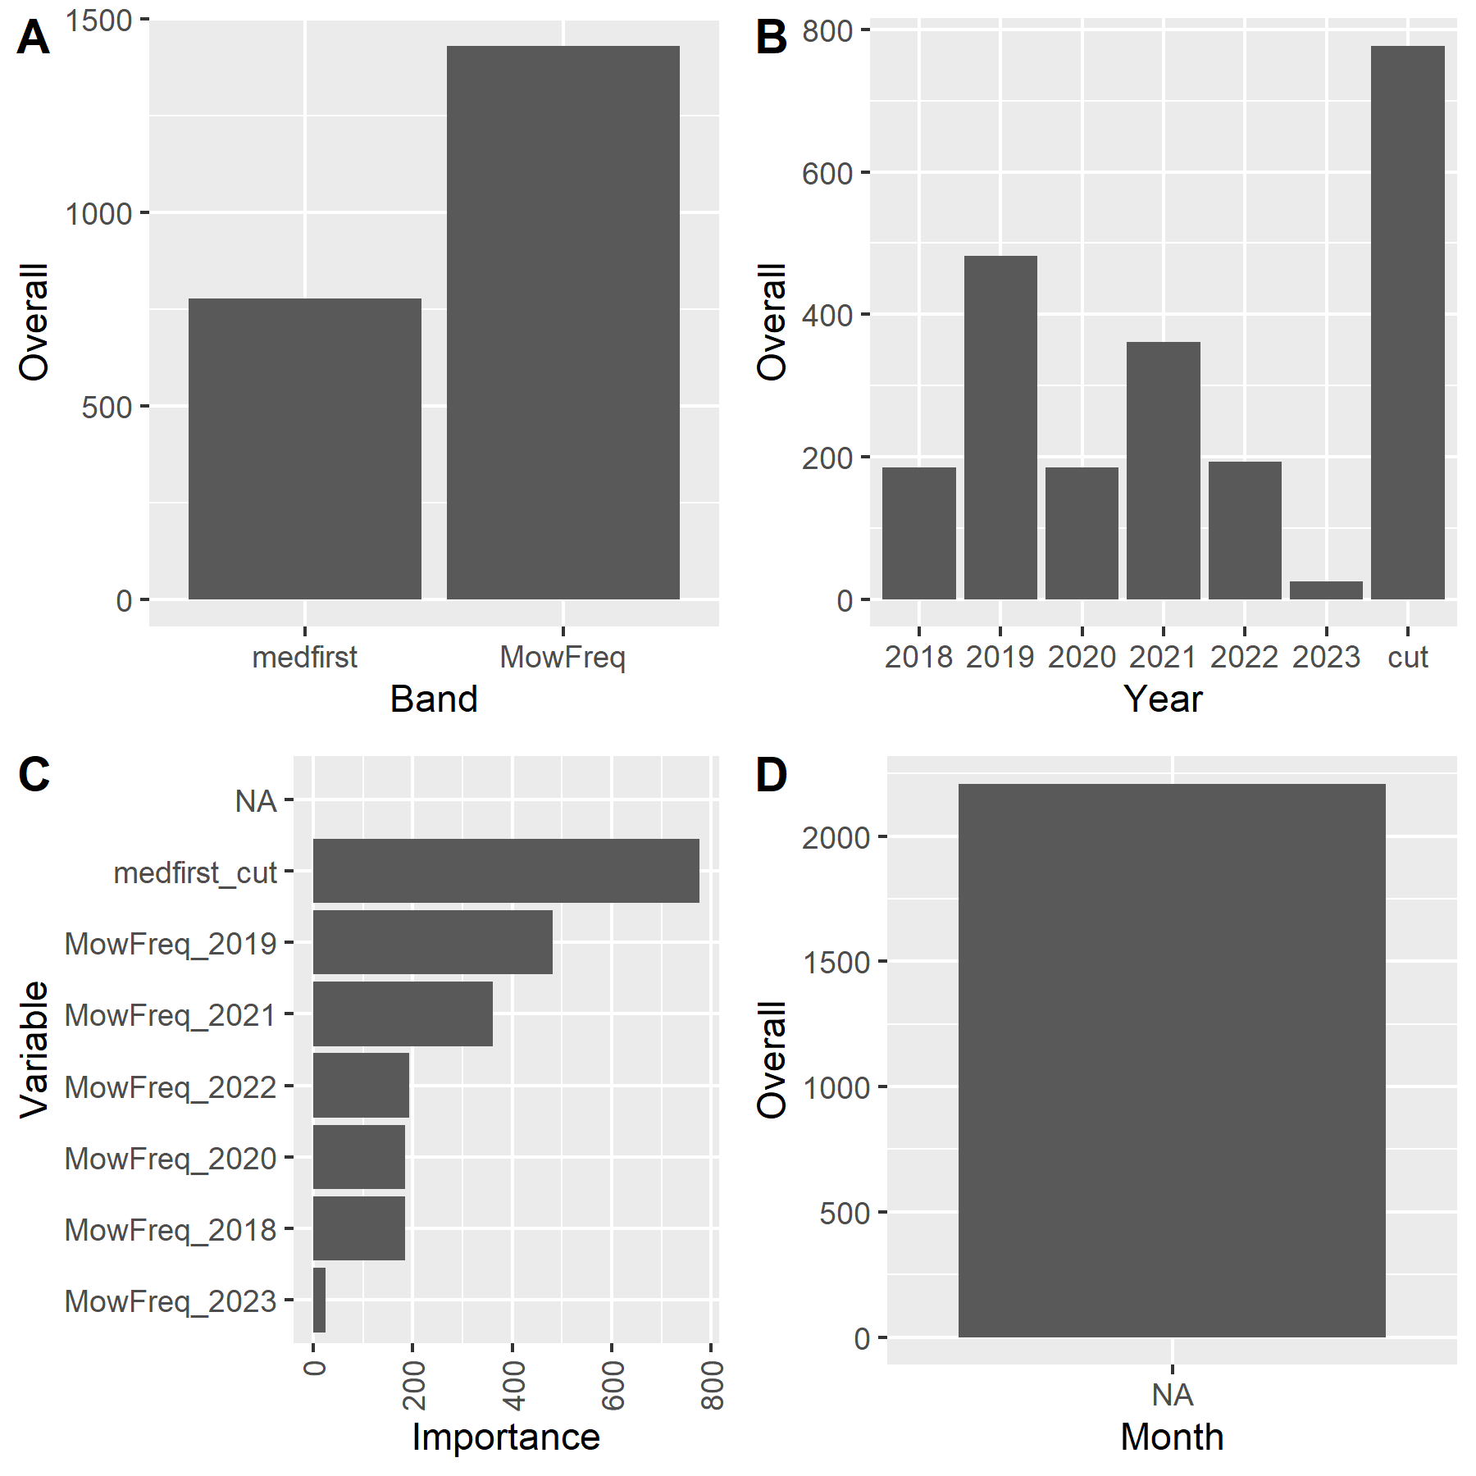
RF trained with Mowing Data only
Notes:
Median DOY of first cut and yearly mowing frequency

Slide 11
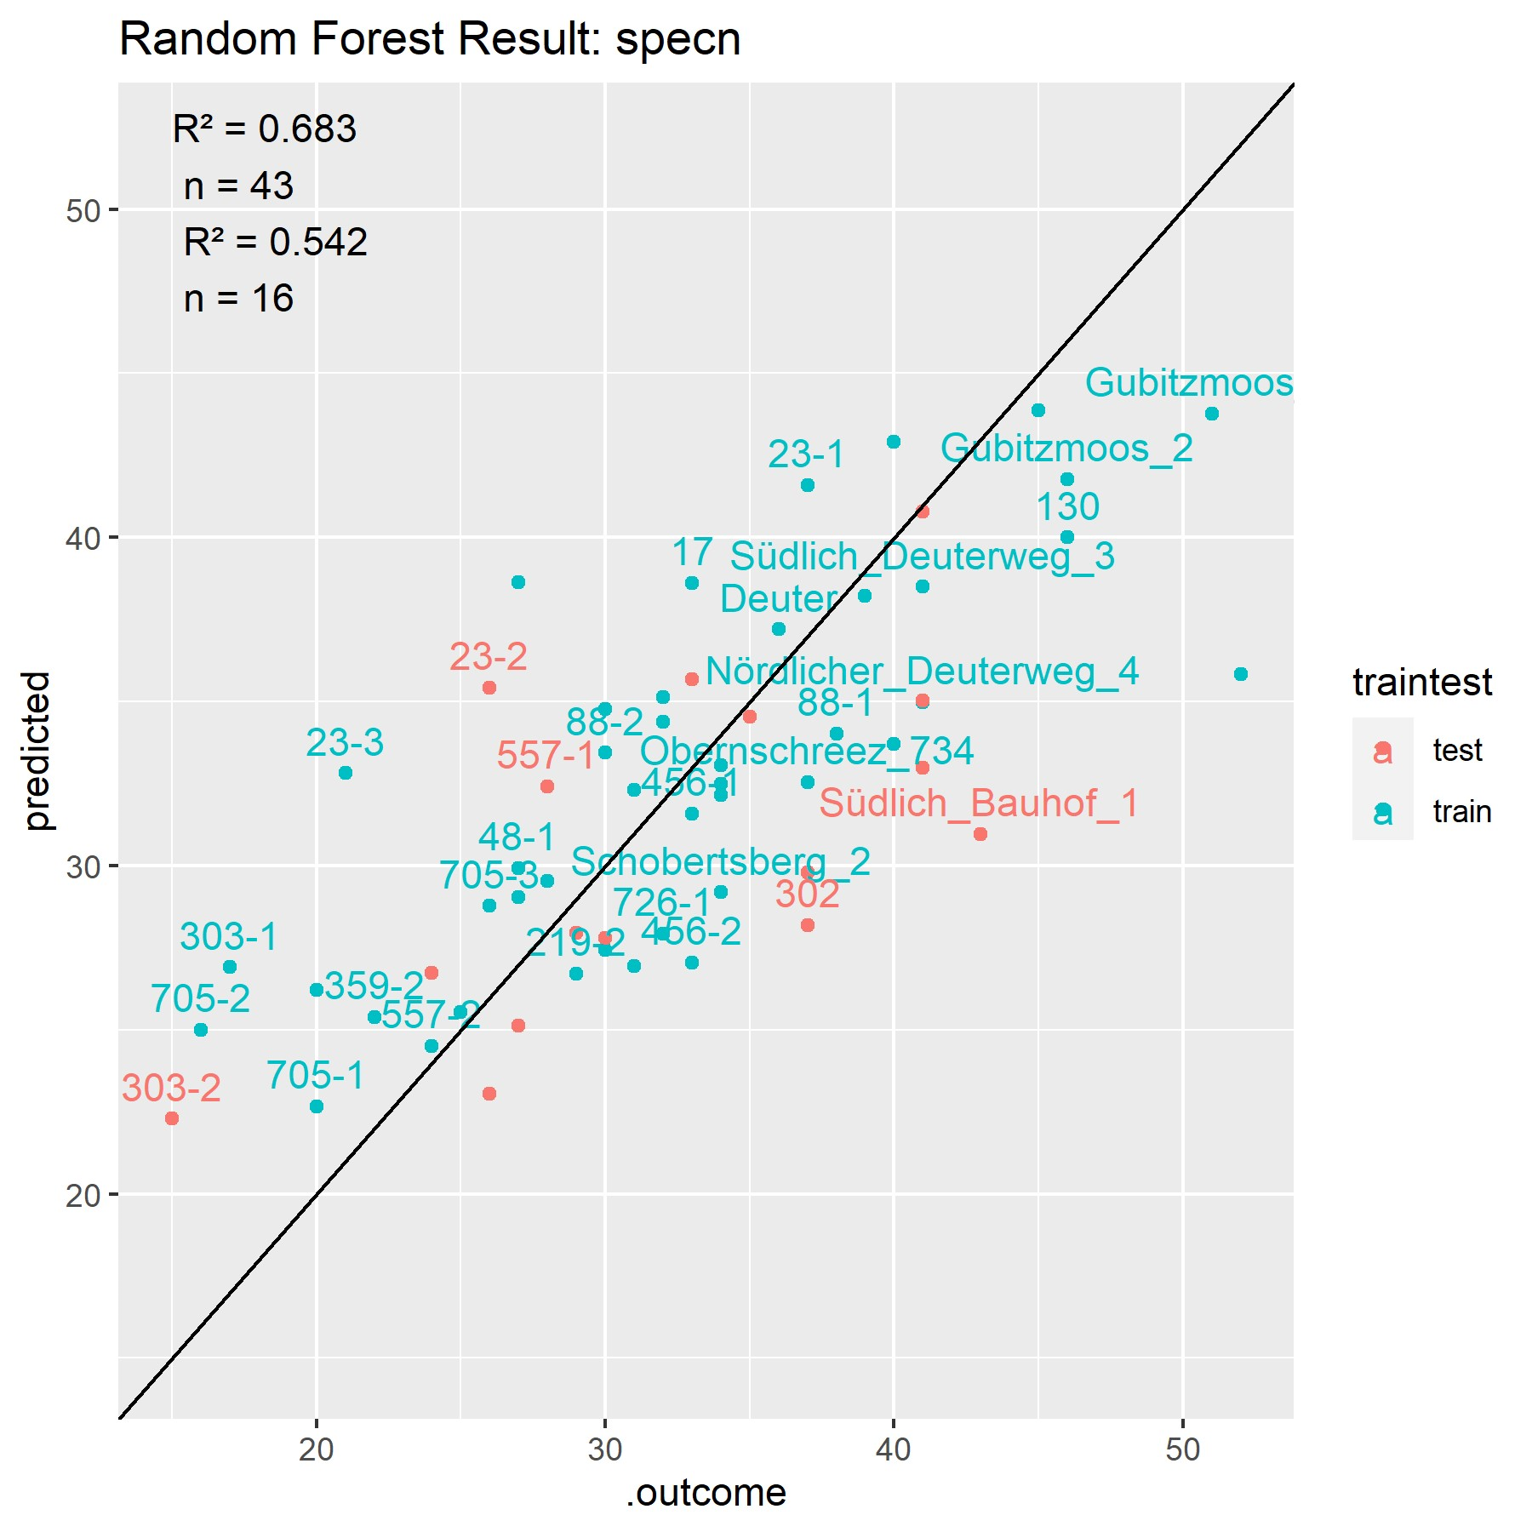
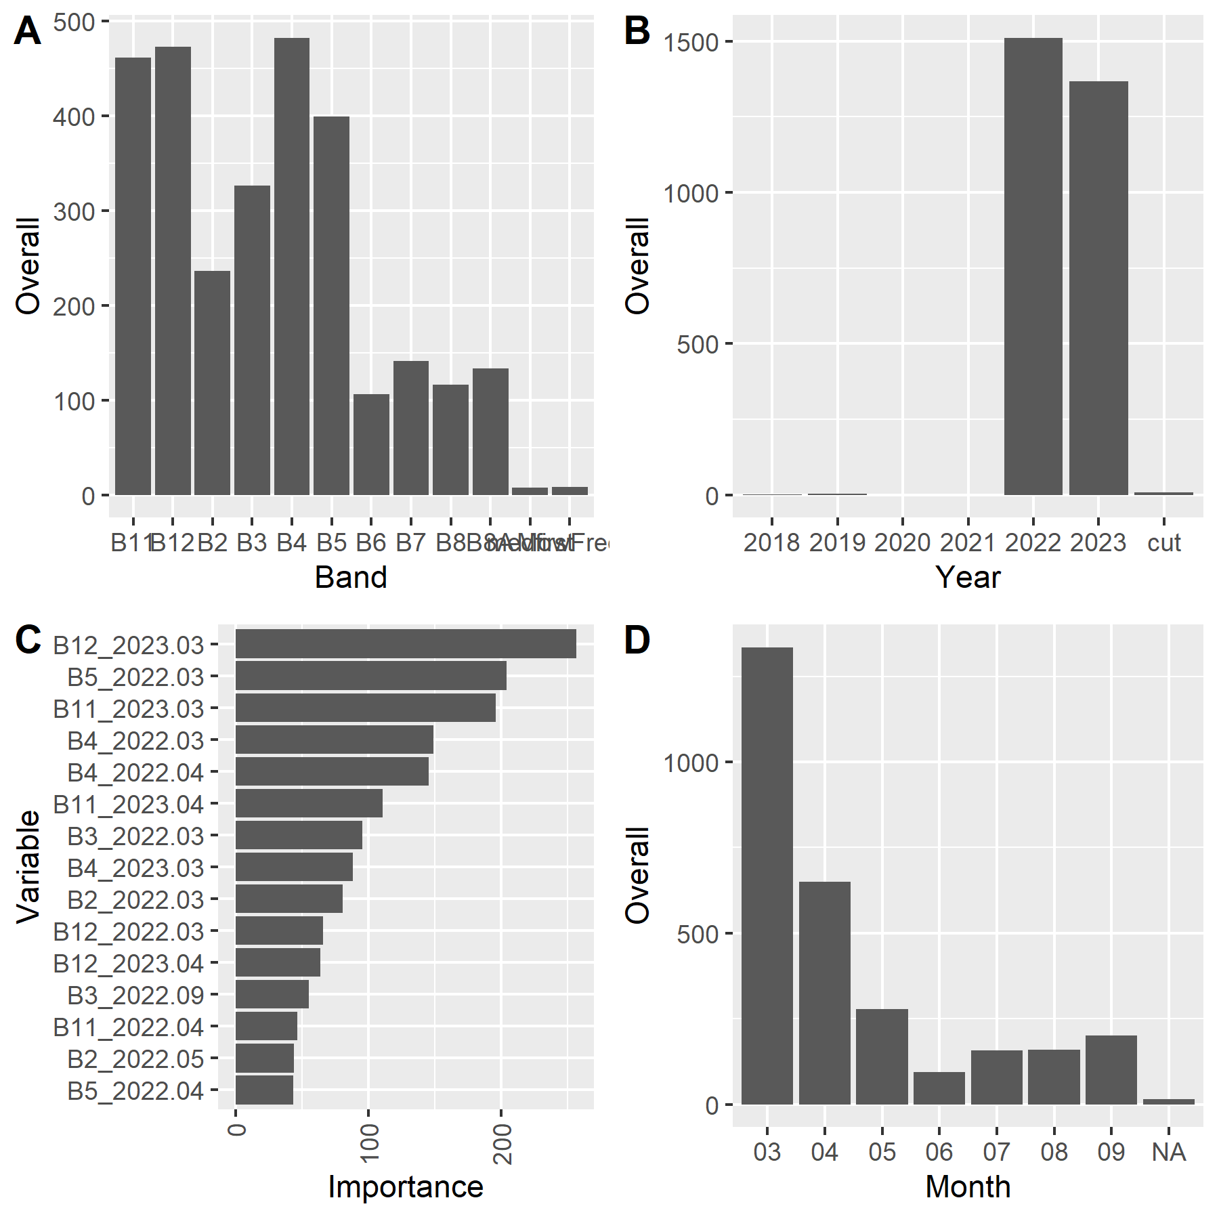
RF trained with Reflectance and Mowing Data

